Slide 1
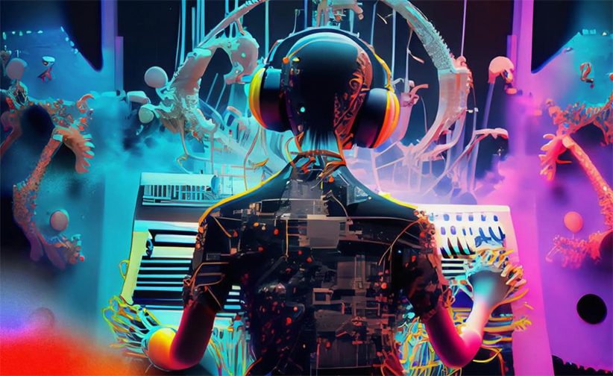
MUSE - Machine enhanced User Sound Experience
Shivam Arora, Aman Soni, Zubair Qazi, Sidharth
Image taken from https://ampedstudio.com/ai-in-music/
Department of CSE, University of Michigan, Ann Arbor

Slide 2
Problem Statement
Domain: Audio HAI
Current music apps rely on fixed equalizers and static presets, with little personalization.
Different listeners, different needs: neurodivergent users may be sensitive to noise, accessibility users may need clarity, and others want context-based mixes (workout vs studying).
No system today learns and adapts in real time to a person’s preferred way of hearing music.

Slide 3
Goals for User Research
Understand the users’:
  satisfaction or dissatisfaction with current systems
  requirements for a new system
Prioritize user-driven or AI-driven experience?
UI/UX feedback
Potential constraints of the system

